Slide 1

Advance SQL
PreHire Training
Strategy & Analytics, June 2020

Slide 2


Course Content
Restricting & Sorting
Single Row Functions
Restricting & Sorting
Joining Multiple Tables
Aggregation
Analytical Functions
Subqueries
Set Operators
Hierarchical Retrieval
Additional Practice
Appendix

Slide 3

Course Content
1
Restricting & Sorting
2
Single Row Functions
Course Content
Restricting & Sorting
3
Joining Multiple Tables
Single Row Functions
4
Aggregation
Joining Multiple Tables
Aggregation
5
Analytical Functions
Analytical Functions
6
Subqueries
Subqueries
7
Set Operators
Set Operators
Hierarchical Retrieval
8
Hierarchical Retrieval
Additional Practice
Appendix
9
Additional Practice
10
Appendix

Slide 4
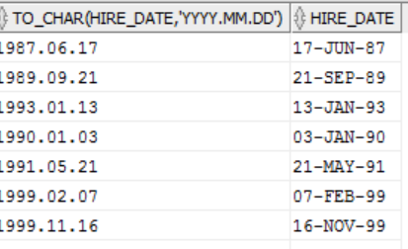
Restricting Data
Where clause can compare
SELECT TO_CHAR(HIRE_DATE,'YYYY.MM.DD') FROM EMPLOYEES;
Values in columns
Literal values
Arithmetic expressions, or
Functions
Course Content
Restricting & Sorting
Single Row Functions
Joining Multiple Tables
Character Strings and Dates
Aggregation
Enclosed in single quotation marks
Character values are case sensitive
Date values are format sensitive
Default data format is – DD-MON-RR
Analytical Functions
Subqueries
Set Operators
Hierarchical Retrieval
Additional Practice
Appendix

Slide 5
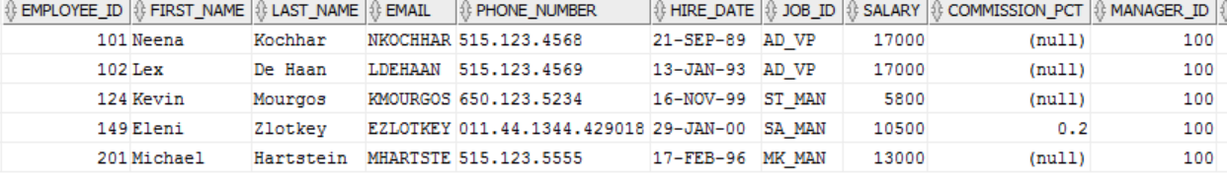
Limiting Rows Selected
SELECT [ DISTINCT ] { * | column [alias], … }
FROM table
[ WHERE condition (s) ] ;
Course Content
Restricting & Sorting
Single Row Functions
Joining Multiple Tables
select * from employees where MANAGER_ID=100;
Aggregation
Analytical Functions
Subqueries
Set Operators
Hierarchical Retrieval
Additional Practice
Appendix

Slide 6
Comparison Operators
Syntax
-- WHERE expr operator value
Course Content
Restricting & Sorting
Single Row Functions
Joining Multiple Tables
General Comparison Operators
Other comparison operators
Aggregation
Analytical Functions
=
>
>=
<
<=
<>
BETWEEN … AND … → Between two values (inclusive)
IN(list) → Matches any value in list of values
LIKE → Match a character pattern
IS NULL → Is a null value
Subqueries
Set Operators
Hierarchical Retrieval
Additional Practice
Appendix

Slide 7
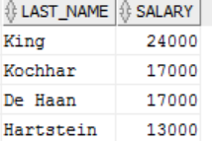
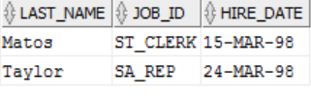
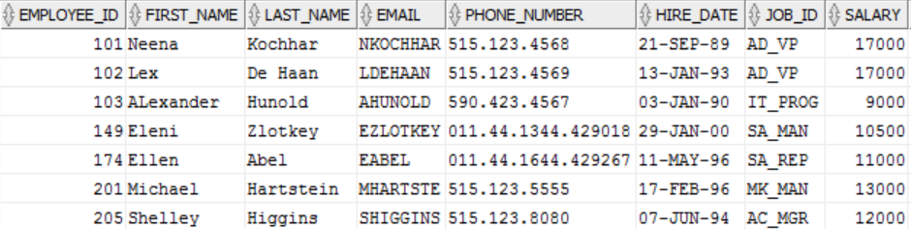
Examples
Display last name and department number for employees earning more than $12000
SELECT LAST_NAME, SALARY FROM EMPLOYEES
WHERE SALARY > 12000;
Course Content
Restricting & Sorting
Display last name, JOB_ID, and start date of employees hired between Feb 20, 1998 and May 1, 1998. Order the results in ascending order of Start Date
SELECT LAST_NAME, JOB_ID, HIRE_DATE FROM EMPLOYEES WHERE HIRE_DATE BETWEEN '20-FEB-98' AND '01-MAY-98' ORDER BY HIRE_DATE;
Single Row Functions
Joining Multiple Tables
Aggregation
Analytical Functions
Subqueries
Display Employees earning in the range of $9000 to $2000
SELECT * FROM EMPLOYEES WHERE SALARY BETWEEN 9000 AND 20000;
Set Operators
Hierarchical Retrieval
Additional Practice
Appendix
Notes:
-- CREATE ALL TABLES
CREATE TABLE COUNTRIES (COUNTRY_ID CHAR(2) NOT NULL, COUNTRY_NAME VARCHAR2(40), REGION_ID NUMBER);
CREATE TABLE DEPARTMENTS (DEPARTMENT_ID NUMBER(4) NOT NULL, DEPARTMENT_NAME VARCHAR2(30) NOT NULL, MANAGER_ID NUMBER(6), LOCATION_ID NUMBER(4));
CREATE TABLE EMPLOYEES (EMPLOYEE_ID NUMBER(6) NOT NULL, FIRST_NAME VARCHAR2(20), LAST_NAME VARCHAR2(25) NOT NULL, EMAIL VARCHAR2(25) NOT NULL, PHONE_NUMBER VARCHAR2(20), HIRE_DATE DATE NOT NULL, JOB_ID VARCHAR2(10), SALARY NUMBER(8,2), COMMISSION_PCT NUMBER(2,2), MANAGER_ID NUMBER(6), DEPARTMENT_ID NUMBER(4));
CREATE TABLE JOBS (JOB_ID VARCHAR2(10) NOT NULL, JOB_TITLE VARCHAR2(35) NOT NULL, MIN_SALARY NUMBER(6), MAX_SALARY NUMBER(6));
CREATE TABLE JOB_GRADES (GRADE_LEVEL VARCHAR2(3), LOWEST_SAL NUMBER, HIGHEST_SAL NUMBER);
CREATE TABLE JOB_HISTORY (EMPLOYEE_ID NUMBER(6) NOT NULL, START_DATE DATE NOT NULL, END_DATE DATE NOT NULL, JOB_ID VARCHAR2(10) NOT NULL, DEPARTMENT_ID NUMBER(4));
CREATE TABLE LOCATIONS(LOCATION_ID NUMBER(4) NOT NULL, STREET_ADDRESS VARCHAR2(40), POSTAL_CODE VARCHAR2(12), CITY VARCHAR2(30) NOT NULL, STATE_PROVINCE VARCHAR2(25), COUNTRY_ID CHAR(2));
CREATE TABLE REGIONS (REGION_ID NUMBER NOT NULL, REGION_NAME VARCHAR2(25));
-- TRUNCATE ALL TABLES
TRUNCATE TABLE COUNTRIES;
TRUNCATE TABLE DEPARTMENTS;
TRUNCATE TABLE EMPLOYEES;
TRUNCATE TABLE JOBS;
TRUNCATE TABLE JOB_GRADES;
TRUNCATE TABLE JOB_HISTORY;
TRUNCATE TABLE LOCATIONS;
TRUNCATE TABLE REGIONS;
-- INSERT ROWS IN COUNTRIES TABLE
INSERT INTO COUNTRIES (COUNTRY_ID, COUNTRY_NAME, REGION_ID) VALUES ('CA', 'Canada', 2);
INSERT INTO COUNTRIES (COUNTRY_ID, COUNTRY_NAME, REGION_ID) VALUES ('DE', 'Germany', 1);
INSERT INTO COUNTRIES (COUNTRY_ID, COUNTRY_NAME, REGION_ID) VALUES ('UK', 'United Kingdom', 1);
INSERT INTO COUNTRIES (COUNTRY_ID, COUNTRY_NAME, REGION_ID) VALUES ('US', 'United States of America', 2);
COMMIT;
-- INSERT ROWS IN DEPARTMENTS TABLE
INSERT INTO DEPARTMENTS (DEPARTMENT_ID, DEPARTMENT_NAME, MANAGER_ID, LOCATION_ID) VALUES (10, 'Administration', 200, 1700);
INSERT INTO DEPARTMENTS (DEPARTMENT_ID, DEPARTMENT_NAME, MANAGER_ID, LOCATION_ID) VALUES (20, 'Marketing', 201, 1800);
INSERT INTO DEPARTMENTS (DEPARTMENT_ID, DEPARTMENT_NAME, MANAGER_ID, LOCATION_ID) VALUES (50, 'Shipping', 124, 1500);
INSERT INTO DEPARTMENTS (DEPARTMENT_ID, DEPARTMENT_NAME, MANAGER_ID, LOCATION_ID) VALUES (60, 'IT', 103, 1400);
INSERT INTO DEPARTMENTS (DEPARTMENT_ID, DEPARTMENT_NAME, MANAGER_ID, LOCATION_ID) VALUES (80, 'Sales', 149, 2500);
INSERT INTO DEPARTMENTS (DEPARTMENT_ID, DEPARTMENT_NAME, MANAGER_ID, LOCATION_ID) VALUES (90, 'Executive', 100, 1700);
INSERT INTO DEPARTMENTS (DEPARTMENT_ID, DEPARTMENT_NAME, MANAGER_ID, LOCATION_ID) VALUES (110, 'Accounting', 205, 1700);
INSERT INTO DEPARTMENTS (DEPARTMENT_ID, DEPARTMENT_NAME, MANAGER_ID, LOCATION_ID) VALUES (190, 'Contracting', NULL, 1700);
COMMIT;
-- INSERT ROWS INTO EMPLOYEES TABLE
INSERT INTO EMPLOYEES (EMPLOYEE_ID, FIRST_NAME, LAST_NAME, EMAIL, PHONE_NUMBER, HIRE_DATE, JOB_ID, SALARY, COMMISSION_PCT, MANAGER_ID, DEPARTMENT_ID) VALUES (100, 'Steven', 'King', 'SKING', '515.123.4567', '17-JUN-87', 'AD_PRES', 24000, NULL, NULL, 90);
INSERT INTO EMPLOYEES (EMPLOYEE_ID, FIRST_NAME, LAST_NAME, EMAIL, PHONE_NUMBER, HIRE_DATE, JOB_ID, SALARY, COMMISSION_PCT, MANAGER_ID, DEPARTMENT_ID) VALUES (101, 'Neena', 'Kochhar', 'NKOCHHAR', '515.123.4568', '21-SEP-89', 'AD_VP', 17000, NULL, 100, 90);
INSERT INTO EMPLOYEES (EMPLOYEE_ID, FIRST_NAME, LAST_NAME, EMAIL, PHONE_NUMBER, HIRE_DATE, JOB_ID, SALARY, COMMISSION_PCT, MANAGER_ID, DEPARTMENT_ID) VALUES (102, 'Lex', 'De Haan', 'LDEHAAN', '515.123.4569', '13-JAN-93', 'AD_VP', 17000, NULL, 100, 90);
INSERT INTO EMPLOYEES (EMPLOYEE_ID, FIRST_NAME, LAST_NAME, EMAIL, PHONE_NUMBER, HIRE_DATE, JOB_ID, SALARY, COMMISSION_PCT, MANAGER_ID, DEPARTMENT_ID) VALUES (103, 'ALexander', 'Hunold', 'AHUNOLD', '590.423.4567', '03-JAN-90', 'IT_PROG', 9000, NULL, 102, 60);
INSERT INTO EMPLOYEES (EMPLOYEE_ID, FIRST_NAME, LAST_NAME, EMAIL, PHONE_NUMBER, HIRE_DATE, JOB_ID, SALARY, COMMISSION_PCT, MANAGER_ID, DEPARTMENT_ID) VALUES (104, 'Bruce', 'Ernst', 'BERNST', '590.423.4568', '21-MAY-91', 'IT_PROG', 6000, NULL, 103, 60);
INSERT INTO EMPLOYEES (EMPLOYEE_ID, FIRST_NAME, LAST_NAME, EMAIL, PHONE_NUMBER, HIRE_DATE, JOB_ID, SALARY, COMMISSION_PCT, MANAGER_ID, DEPARTMENT_ID) VALUES (107, 'Diana', 'Lorentz', 'DLORENTZ', '590.423.5567', '07-FEB-99', 'IT_PROG', 4200, NULL, 103, 60);
INSERT INTO EMPLOYEES (EMPLOYEE_ID, FIRST_NAME, LAST_NAME, EMAIL, PHONE_NUMBER, HIRE_DATE, JOB_ID, SALARY, COMMISSION_PCT, MANAGER_ID, DEPARTMENT_ID) VALUES (124, 'Kevin', 'Mourgos', 'KMOURGOS', '650.123.5234', '16-NOV-99', 'ST_MAN', 5800, NULL, 100, 50);
INSERT INTO EMPLOYEES (EMPLOYEE_ID, FIRST_NAME, LAST_NAME, EMAIL, PHONE_NUMBER, HIRE_DATE, JOB_ID, SALARY, COMMISSION_PCT, MANAGER_ID, DEPARTMENT_ID) VALUES (141, 'Trenna', 'Rajs', 'TRAJS', '650.121.8009', '17-OCT-95', 'ST_CLERK', 3500, NULL, 124, 50);
INSERT INTO EMPLOYEES (EMPLOYEE_ID, FIRST_NAME, LAST_NAME, EMAIL, PHONE_NUMBER, HIRE_DATE, JOB_ID, SALARY, COMMISSION_PCT, MANAGER_ID, DEPARTMENT_ID) VALUES (142, 'Curtis', 'Davies', 'CDAVIES', '650.121.2994', '29-JAN-97', 'ST_CLERK', 3100, NULL, 124, 50);
INSERT INTO EMPLOYEES (EMPLOYEE_ID, FIRST_NAME, LAST_NAME, EMAIL, PHONE_NUMBER, HIRE_DATE, JOB_ID, SALARY, COMMISSION_PCT, MANAGER_ID, DEPARTMENT_ID) VALUES (143, 'Randall', 'Matos', 'RMATOS', '650.121.2874', '15-MAR-98', 'ST_CLERK', 2600, NULL, 124, 50);
INSERT INTO EMPLOYEES (EMPLOYEE_ID, FIRST_NAME, LAST_NAME, EMAIL, PHONE_NUMBER, HIRE_DATE, JOB_ID, SALARY, COMMISSION_PCT, MANAGER_ID, DEPARTMENT_ID) VALUES (144, 'Peter', 'Vargas', 'PVARGAS', '650.121.2004', '09-JUL-98', 'ST_CLERK', 2500, NULL, 124, 50);
INSERT INTO EMPLOYEES (EMPLOYEE_ID, FIRST_NAME, LAST_NAME, EMAIL, PHONE_NUMBER, HIRE_DATE, JOB_ID, SALARY, COMMISSION_PCT, MANAGER_ID, DEPARTMENT_ID) VALUES (149, 'Eleni', 'Zlotkey', 'EZLOTKEY', '011.44.1344.429018', '29-JAN-00', 'SA_MAN', 10500, .2, 100, 80);
INSERT INTO EMPLOYEES (EMPLOYEE_ID, FIRST_NAME, LAST_NAME, EMAIL, PHONE_NUMBER, HIRE_DATE, JOB_ID, SALARY, COMMISSION_PCT, MANAGER_ID, DEPARTMENT_ID) VALUES (174, 'Ellen', 'Abel', 'EABEL', '011.44.1644.429267', '11-MAY-96', 'SA_REP', 11000, .3, 149, 80);
INSERT INTO EMPLOYEES (EMPLOYEE_ID, FIRST_NAME, LAST_NAME, EMAIL, PHONE_NUMBER, HIRE_DATE, JOB_ID, SALARY, COMMISSION_PCT, MANAGER_ID, DEPARTMENT_ID) VALUES (176, 'Jonathon', 'Taylor', 'JTAYLOR', '011.44.1644.429265', '24-MAR-98', 'SA_REP', 8600, .2, 149, 80);
INSERT INTO EMPLOYEES (EMPLOYEE_ID, FIRST_NAME, LAST_NAME, EMAIL, PHONE_NUMBER, HIRE_DATE, JOB_ID, SALARY, COMMISSION_PCT, MANAGER_ID, DEPARTMENT_ID) VALUES (178, 'Kimberely', 'Grant', 'KGRANT', '011.44.1644.429263', '24-MAY-99', 'SA_REP', 7000, .15, 149, NULL);
INSERT INTO EMPLOYEES (EMPLOYEE_ID, FIRST_NAME, LAST_NAME, EMAIL, PHONE_NUMBER, HIRE_DATE, JOB_ID, SALARY, COMMISSION_PCT, MANAGER_ID, DEPARTMENT_ID) VALUES (200, 'Jennifer', 'Whalen', 'JWHALEN', '515.123.4444', '17-SEP-87', 'AD_ASST', 4400, NULL, 101, 10);
INSERT INTO EMPLOYEES (EMPLOYEE_ID, FIRST_NAME, LAST_NAME, EMAIL, PHONE_NUMBER, HIRE_DATE, JOB_ID, SALARY, COMMISSION_PCT, MANAGER_ID, DEPARTMENT_ID) VALUES (201, 'Michael', 'Hartstein', 'MHARTSTE', '515.123.5555', '17-FEB-96', 'MK_MAN', 13000, NULL, 100, 20);
INSERT INTO EMPLOYEES (EMPLOYEE_ID, FIRST_NAME, LAST_NAME, EMAIL, PHONE_NUMBER, HIRE_DATE, JOB_ID, SALARY, COMMISSION_PCT, MANAGER_ID, DEPARTMENT_ID) VALUES (202, 'Pat', 'Fay', 'PFAY', '603.123.6666', '17-AUG-97', 'MK_REP', 6000, NULL, 201, 20);
INSERT INTO EMPLOYEES (EMPLOYEE_ID, FIRST_NAME, LAST_NAME, EMAIL, PHONE_NUMBER, HIRE_DATE, JOB_ID, SALARY, COMMISSION_PCT, MANAGER_ID, DEPARTMENT_ID) VALUES (205, 'Shelley', 'Higgins', 'SHIGGINS', '515.123.8080', '07-JUN-94', 'AC_MGR', 12000, NULL, 101, 110);
INSERT INTO EMPLOYEES (EMPLOYEE_ID, FIRST_NAME, LAST_NAME, EMAIL, PHONE_NUMBER, HIRE_DATE, JOB_ID, SALARY, COMMISSION_PCT, MANAGER_ID, DEPARTMENT_ID) VALUES (206, 'William', 'Gietz', 'WGIETZ', '515.123.8181', '07-JUN-94', 'AC_ACCOUNT', 8300, NULL, 205, 110);
COMMIT;
-- INSERT ROWS INTO JOBS TABLE
INSERT INTO JOBS (JOB_ID, JOB_TITLE, MIN_SALARY, MAX_SALARY) VALUES ('AD_PRES', 'President', 20000, 40000);
INSERT INTO JOBS (JOB_ID, JOB_TITLE, MIN_SALARY, MAX_SALARY) VALUES ('AD_VP', 'Administration Vice President', 15000, 30000);
INSERT INTO JOBS (JOB_ID, JOB_TITLE, MIN_SALARY, MAX_SALARY) VALUES ('AD_ASST', 'Administration Assistant', 3000, 6000);
INSERT INTO JOBS (JOB_ID, JOB_TITLE, MIN_SALARY, MAX_SALARY) VALUES ('AC_MGR', 'Accounting Manager', 8200, 16000);
INSERT INTO JOBS (JOB_ID, JOB_TITLE, MIN_SALARY, MAX_SALARY) VALUES ('AC_ACCOUNT', 'Public Accountant', 4200, 9000);
INSERT INTO JOBS (JOB_ID, JOB_TITLE, MIN_SALARY, MAX_SALARY) VALUES ('SA_MAN', 'Sales Manager', 10000, 20000);
INSERT INTO JOBS (JOB_ID, JOB_TITLE, MIN_SALARY, MAX_SALARY) VALUES ('SA_REP', 'Sales Representative', 6000, 12000);
INSERT INTO JOBS (JOB_ID, JOB_TITLE, MIN_SALARY, MAX_SALARY) VALUES ('ST_MAN', 'Stock Manager', 5500, 8500);
INSERT INTO JOBS (JOB_ID, JOB_TITLE, MIN_SALARY, MAX_SALARY) VALUES ('ST_CLERK', 'Stock Clerk', 2000, 5000);
INSERT INTO JOBS (JOB_ID, JOB_TITLE, MIN_SALARY, MAX_SALARY) VALUES ('IT_PROG', 'Programmer', 4000, 10000);
INSERT INTO JOBS (JOB_ID, JOB_TITLE, MIN_SALARY, MAX_SALARY) VALUES ('MK_MAN', 'Marketing Manager', 9000, 15000);
INSERT INTO JOBS (JOB_ID, JOB_TITLE, MIN_SALARY, MAX_SALARY) VALUES ('MK_REP', 'Marketing Representative', 4000, 9000);
COMMIT;
-- INSERT ROWS INTO JOB_GRADES TABLE
INSERT INTO JOB_GRADES (GRADE_LEVEL, LOWEST_SAL, HIGHEST_SAL) VALUES ('A', 1000, 2999);
INSERT INTO JOB_GRADES (GRADE_LEVEL, LOWEST_SAL, HIGHEST_SAL) VALUES ('B', 3000, 5999);
INSERT INTO JOB_GRADES (GRADE_LEVEL, LOWEST_SAL, HIGHEST_SAL) VALUES ('C', 6000, 9999);
INSERT INTO JOB_GRADES (GRADE_LEVEL, LOWEST_SAL, HIGHEST_SAL) VALUES ('D', 10000, 14999);
INSERT INTO JOB_GRADES (GRADE_LEVEL, LOWEST_SAL, HIGHEST_SAL) VALUES ('E', 15000, 24999);
INSERT INTO JOB_GRADES (GRADE_LEVEL, LOWEST_SAL, HIGHEST_SAL) VALUES ('F', 25000, 40000);
COMMIT;
-- INSERT ROWS INTO JOB_HISTORY TABLE
INSERT INTO JOB_HISTORY (EMPLOYEE_ID, START_DATE, END_DATE, JOB_ID, DEPARTMENT_ID) VALUES (102, '13-JAN-93', '24-JUL-98', 'IT_PROG', 60);
INSERT INTO JOB_HISTORY (EMPLOYEE_ID, START_DATE, END_DATE, JOB_ID, DEPARTMENT_ID) VALUES (101, '21-SEP-89', '27-OCT-93', 'AC_ACCOUNT', 110);
INSERT INTO JOB_HISTORY (EMPLOYEE_ID, START_DATE, END_DATE, JOB_ID, DEPARTMENT_ID) VALUES (101, '28-OCT-93', '15-MAR-97', 'AC_MGR', 110);
INSERT INTO JOB_HISTORY (EMPLOYEE_ID, START_DATE, END_DATE, JOB_ID, DEPARTMENT_ID) VALUES (201, '17-FEB-96', '19-DEC-99', 'MK_REP', 20);
INSERT INTO JOB_HISTORY (EMPLOYEE_ID, START_DATE, END_DATE, JOB_ID, DEPARTMENT_ID) VALUES (114, '24-MAR-98', '31-DEC-99', 'ST_CLERK', 50);
INSERT INTO JOB_HISTORY (EMPLOYEE_ID, START_DATE, END_DATE, JOB_ID, DEPARTMENT_ID) VALUES (122, '01-JAN-99', '31-DEC-99', 'ST_CLERK', 50);
INSERT INTO JOB_HISTORY (EMPLOYEE_ID, START_DATE, END_DATE, JOB_ID, DEPARTMENT_ID) VALUES (200, '17-SEP-87', '17-JUN-93', 'AD_ASST', 90);
INSERT INTO JOB_HISTORY (EMPLOYEE_ID, START_DATE, END_DATE, JOB_ID, DEPARTMENT_ID) VALUES (176, '24-MAR-98', '31-DEC-98', 'SA_REP', 80);
INSERT INTO JOB_HISTORY (EMPLOYEE_ID, START_DATE, END_DATE, JOB_ID, DEPARTMENT_ID) VALUES (176, '01-JAN-99', '31-DEC-99', 'SA_MAN', 80);
INSERT INTO JOB_HISTORY (EMPLOYEE_ID, START_DATE, END_DATE, JOB_ID, DEPARTMENT_ID) VALUES (200, '01-JUL-94', '31-DEC-98', 'AC_ACCOUNT', 90);
COMMIT;
-- INSERT ROWS INTO LOCATIONS TABLE
INSERT INTO LOCATIONS (LOCATION_ID, STREET_ADDRESS, POSTAL_CODE, CITY, STATE_PROVINCE, COUNTRY_ID) VALUES (1400, '2014 Jabberwocky Rd', '26192', 'Southlake', 'Texas', 'US');
INSERT INTO LOCATIONS (LOCATION_ID, STREET_ADDRESS, POSTAL_CODE, CITY, STATE_PROVINCE, COUNTRY_ID) VALUES (1500, '2011 Interiors Blvd', '99236', 'South San Francisco', 'California', 'US');
INSERT INTO LOCATIONS (LOCATION_ID, STREET_ADDRESS, POSTAL_CODE, CITY, STATE_PROVINCE, COUNTRY_ID) VALUES (1700, '2004 Charade Rd', '98199', 'Seattle', 'Washington', 'US');
INSERT INTO LOCATIONS (LOCATION_ID, STREET_ADDRESS, POSTAL_CODE, CITY, STATE_PROVINCE, COUNTRY_ID) VALUES (1800, '460 Bloor St. W.', 'ON M5S 1X8', 'Toronto', 'Ontario', 'CA');
INSERT INTO LOCATIONS (LOCATION_ID, STREET_ADDRESS, POSTAL_CODE, CITY, STATE_PROVINCE, COUNTRY_ID) VALUES (2500, 'Magdalen Centre, The Oxford Science Park', 'OX9 9ZB', 'Oxford', 'Oxford', 'UK');
COMMIT;
-- INSERT ROWS INTO REGIONS TABLE
INSERT INTO REGIONS (REGION_ID, REGION_NAME) VALUES (1, 'Europe');
INSERT INTO REGIONS (REGION_ID, REGION_NAME) VALUES (2, 'Americas');
INSERT INTO REGIONS (REGION_ID, REGION_NAME) VALUES (3, 'Asia');
INSERT INTO REGIONS (REGION_ID, REGION_NAME) VALUES (4, 'Middle East and Africa');
COMMIT;

Slide 8
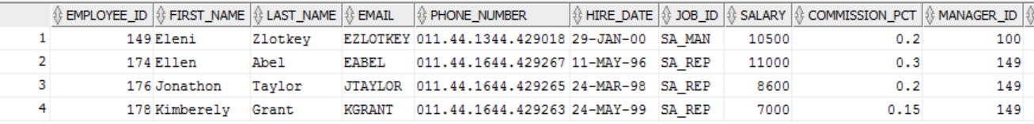
Like
Wildcards
% → any sequence of zero or more characters
_ (underscore) → any single character
ESCAPE Option to match wildcard characters
Course Content
Restricting & Sorting
select * from employees where UPPER(FIRST_NAME) LIKE 'N_ENA%';
Single Row Functions
Joining Multiple Tables
Aggregation
select * FROM EMPLOYEES where JOB_ID LIKE 'SA\_%' ESCAPE '\';
Analytical Functions
Subqueries
Set Operators
Hierarchical Retrieval
select * from employees where FIRST_NAME LIKE 'N_e%';
Additional Practice
Appendix

Slide 9
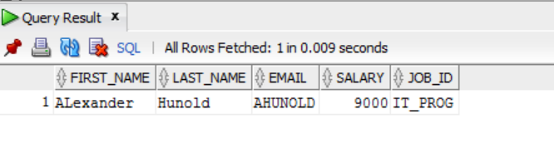
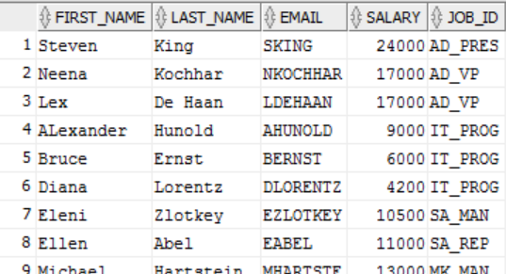
Examples
select FIRST_NAME,LAST_NAME,EMAIL,SALARY,JOB_ID from employees where JOB_ID='IT_PROG' AND SALARY BETWEEN 9000 AND 24000;
Course Content
Restricting & Sorting
Single Row Functions
Joining Multiple Tables
select * from employees where JOB_ID='IT_PROG' OR (SALARY BETWEEN 9000 AND 24000);
Aggregation
Analytical Functions
Subqueries
Set Operators
Hierarchical Retrieval
Additional Practice
Appendix

Slide 10
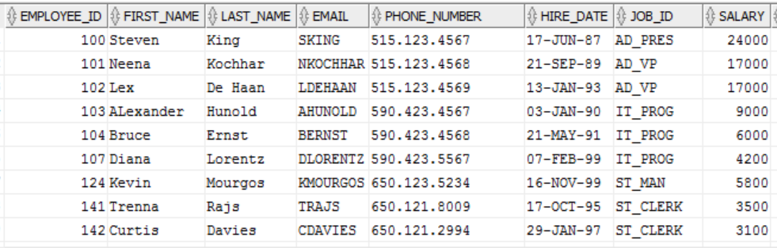
ORDER BY Clause
SELECT expression
FROM table
[WHERE condition(s)]
[ORDER BY {column, expr}|ASC|DESC||;
Course Content
ASC → ascending order (default)
DESC → descending order
Order by must be last clause in Select statement
Restricting & Sorting
Single Row Functions
Joining Multiple Tables
Aggregation
select * from employees ORDER BY EMPLOYEE_ID ASC;
Analytical Functions
Subqueries
Set Operators
Hierarchical Retrieval
Additional Practice
Appendix

Slide 11
Practice Exercise
Display last name and department number for employees earning more than $12000
Display last name and salary for all employees whose salary is not in the range of $5000 and $12000 and are in department 20 or 50
Display last name, JOB_ID, and start date of employees hired between Feb 20, 1998 and May 1, 1998. Order the results in ascending order of Start Date
Display the Last Name and Hire Date of every employee, who was hired in 1994
Display the last name and job title of all employees, who do not have a manager
Display the last name, salary and commission percentage for all employees who earn commissions. Sort data in descending order of salary and commissions
Display the last names of all employees where third letter of the name is an a
Display the last name of all employees who have an a and an e in their last name
Display last name, job and salary for all employees who job is sales representative or stock clerk and whose salary is not equal to $2500, $3500, or $7000
Display last name, salary and commission percentage for all employees whose commission percentage amount is 20%
Course Content
Restricting & Sorting
Single Row Functions
Joining Multiple Tables
Aggregation
Analytical Functions
Subqueries
Set Operators
Hierarchical Retrieval
Additional Practice
Appendix
Notes:
-- select * from EMPLOYEES;
-- I. Display last name and department number for employees earning more than $12000
-- select last_name, department_id from employees where salary > 12000;
-- II. Display last name and salary for all employees whose salary is not in the range of $5000 and $12000 and are in department 20 or 50
-- select last_name, salary,department_id from employees where salary not between '5000' and '12000' and department_id in ('20','50');
-- III. Display last name, JOB_ID, and start date of employees hired between Feb 20, 1998 and May 1, 1998. Order the results in asceing order of Start Date
-- select last_name, Job_id, hire_date "START DATE"
-- from employees
-- where hire_date between '20-FEB-98' and '01-MAY-98'
-- order by 3 ;
-- IV. Display the Last Name and Hire Date of every employee, who was hired in 1994
-- select last_name, hire_date from employees where hire_date like '%94';
-- ##
-- select * from jobs;
-- V. Display the last name and job title of all employees, who do not have a manager
-- describe employees;
-- select last_name, JOB_id from employees where manager_id is null;
-- VI. Display the last name, salary and commission percentage for all employees who earn commissions. Sort data in descending order of salary and commissions
-- select last_name, salary, COMMISSION_PCT from employees where COMMISSION_PCT is not null order by salary,commission_pct ;
-- VII. Display the last names of all employees where third letter of the name is an a
-- select last_name from employees where last_name like '__a%';
-- VIII. Display the last name of all employees who have an a and an e in their last name
-- select last_name from employees where last_name like '%a%' and last_name like '%e%' ;
-- IX. Display last name, job and salary for all employees who job is sales representative or stock clerk and whose salary is not equal to $2500, $3500, or $7000
-- select last_name, job_id, salary from employees
-- where job_id IN('SA_REP','ST_CLERK') and salary not in('2500','3500','7000');
-- X. Display last name, salary and commission percentage for all employees whose commission percentage amount is 20%
-- select last_name,salary,commission_pct from employees where commission_pct = '.2';

Slide 12

Course Content
Restricting & Sorting
Single Row Functions
Single Row Functions
Joining Multiple Tables
Aggregation
Analytical Functions
Subqueries
Set Operators
Hierarchical Retrieval
Additional Practice
Appendix

Slide 13
Overview and Types
Single Row Functions operate on single rows only and return one result per row. They can manipulate data items, data types; accept argument(s) and return one value; can be nested
Course Content
Restricting & Sorting
Character – LOWER, UPPER, INITCAP, CONCAT, SUBSTR, LENGTH, INSTR, LPAD, RPAD, TRIM, REPLACE
General – NVL, NVL2, NULLIF, COALESCE, CASE, DECODE, REGEXP_LIKE, REGEXP_REPLACE
Number – ROUND, TRUNC, MOD
Conversion – TO_CHAR, TO_NUMBER, TO_DATE
Date – MONTHS_BETWEEN, ADD_MONTHS, NEXT_DAY, LAST_DAY, ROUND, TRUNC
Single Row Functions
Joining Multiple Tables
Aggregation
Analytical Functions
Subqueries
Set Operators
Hierarchical Retrieval
Additional Practice
Appendix

Slide 14
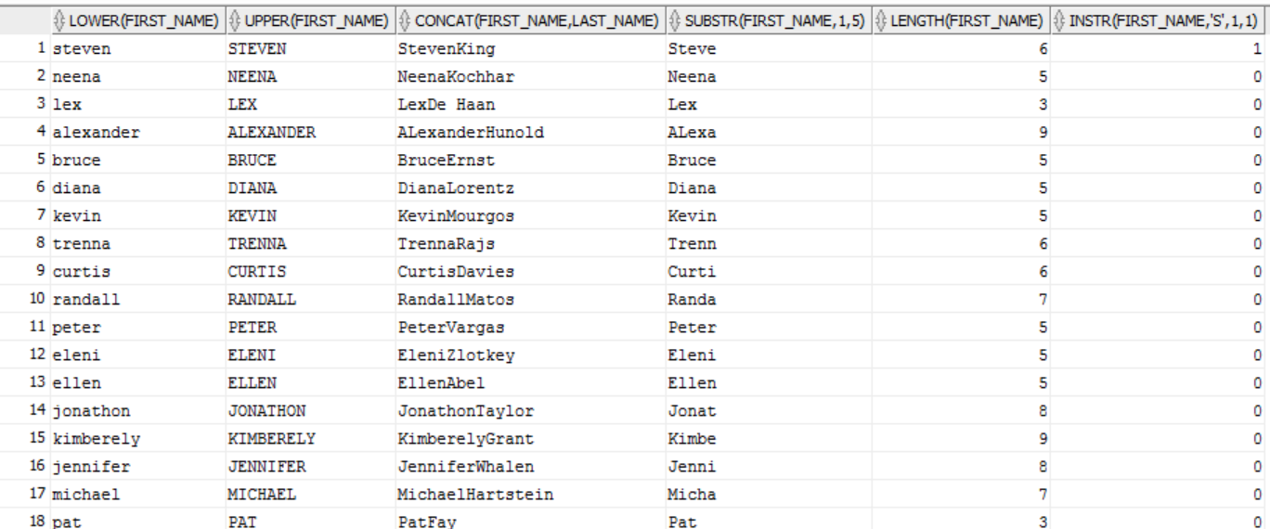
Character functions
INSTR: Searches a string for a substring using characters and returns the position in the string that is the first character of a specified occurrence of the substring. The functions vary in how they determine the position of the substring to return
UPPER: Converts the string to upper case
LOWER: Converts the string to lower case
SUBSTR: Returns the portion of character based on start and length
LENGTH: Returns the length of the string
Course Content
Restricting & Sorting
Single Row Functions
Joining Multiple Tables
SELECT LOWER(FIRST_NAME),UPPER(FIRST_NAME),CONCAT(FIRST_NAME,LAST_NAME),SUBSTR(FIRST_NAME,1,5),
LENGTH(FIRST_NAME),INSTR(FIRST_NAME,'S',1,1)
FROM EMPLOYEES;
Aggregation
Analytical Functions
Subqueries
Set Operators
Hierarchical Retrieval
Additional Practice
Appendix

Slide 15
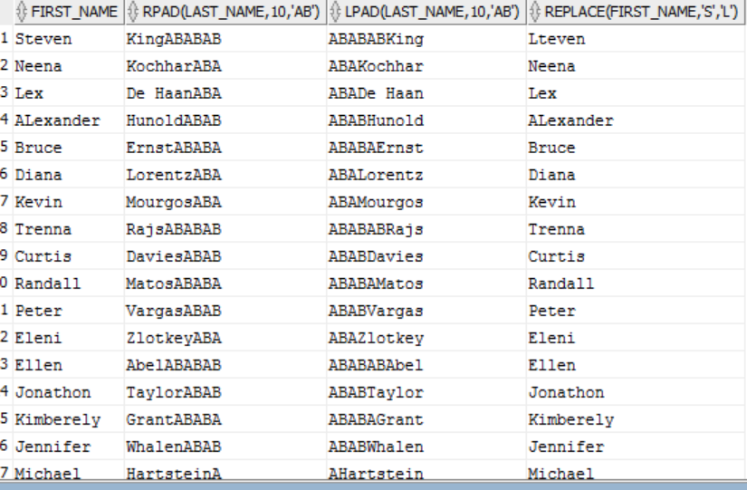
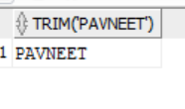
Other Character functions
RPAD/LPAD
TRIM/LTRIM/RTRIM
REPLACE
SELECT FIRST_NAME, RPAD(LAST_NAME,10,'AB'),LPAD(LAST_NAME,10,'AB'),replace(FIRST_NAME,'S','L') FROM EMPLOYEES;
Course Content
Restricting & Sorting
Single Row Functions
SELECT TRIM(' PAVNEET ') FROM DUAL;
Joining Multiple Tables
Aggregation
Analytical Functions
Subqueries
Set Operators
Hierarchical Retrieval
Additional Practice
Appendix

Slide 16
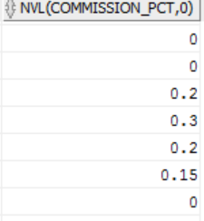
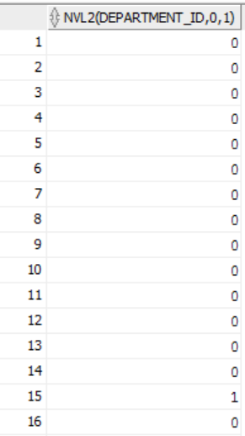
General Functions
NVL: Allows you to replace Null with an expression
NVL2: The NVL2 function accepts three parameters. If the first parameter value is not null it returns the value in the second parameter. If the first parameter value is null, it returns the third parameter.
NULLIF: Compares two arguments and returns null, if the arguments are equal, otherwise the function returns first argument
COALESCE: Returns first not null expression in the argument list
CASE: Chooses from a sequence of conditions, and evaluates a single expression
DECODE: The DECODE function is not specifically for handling null values, but it can be used in a similar way to the NVL function, as shown by the following example
Regular Expressions: Enables to implement complex match logic within database
Course Content
Restricting & Sorting
Single Row Functions
Joining Multiple Tables
Aggregation
Analytical Functions
Select nvl(COMMISSION_PCT,0) FROM EMPLOYEES;
select NVL2(DEPARTMENT_ID,0,1) FROM EMPLOYEES;
Subqueries
Set Operators
Hierarchical Retrieval
Additional Practice
Appendix

Slide 17
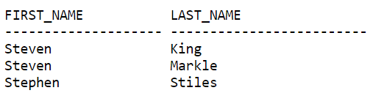
REGEXP_LIKE,REGEXP_REPLACE
REGEXP_LIKE is similar to the LIKE condition, except REGEXP_LIKE performs regular expression matching instead of the simple pattern matching performed by LIKE. This condition evaluates strings using characters as defined by the input character set
REGEXP_REPLACE extends the functionality of the REPLACE function by letting you search a string for a regular expression pattern
Course Content
Restricting & Sorting
Single Row Functions
SELECT first_name, last_name
FROM emp WHERE REGEXP_LIKE (first_name, '^Ste(v|ph)en$');
Joining Multiple Tables
Aggregation
Analytical Functions
Subqueries
The following example examines country name. Oracle puts a space after each non-null character in the string.
Set Operators
Hierarchical Retrieval
Additional Practice
Appendix
SELECT REGEXP_REPLACE(country_name, '(.)', '\1 ') "REGEXP_REPLACE"
FROM countries;

Slide 18
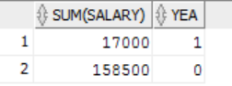
DECODE and CASE
Select sum(salary),decode(TO_CHAR(HIRE_DATE,'YYYY'),'1999',1,0) as YEA FROM EMPLOYEES
group by (decode(TO_CHAR(HIRE_DATE,'YYYY'),'1999',1,0));
Course Content
Restricting & Sorting
Single Row Functions
Joining Multiple Tables
select distinct JOB_ID,
CASE JOB_ID
when 'AD_PRES'
THEN 'A'
WHEN 'IT_PROG'
THEN 'C'
WHEN 'AD_VP'
THEN 'B'
ELSE NULL
END AS GRADE
from employees;
JOB GRADE
AD_PRES A
AD_VP 0
ST_MAN B
IT_PROG C
SA_REP D
ST_CLERK E
…
…
Aggregation
Analytical Functions
Subqueries
Set Operators
Hierarchical Retrieval
Additional Practice
Appendix
Notes:
-- select * from employees-- 1. For each employee, display employee Id, last name, Salary, and the salary increased-- by 15% and expressed as a whole number. Label the column as New Salary.-- Add one more column that subtracts the old salary from New Salary and label the -- column as increase-- select employee_id, last_name, salary, salary*1.15 new_salary, salary*0.15 increase from employees;--2. Write a query that displays the employees’ last names with first letter capitalized and all other letters lowercase and the length of the names, for all employees whose name start with J, A or M. Sort the results by employees’ last names-- Name Length-- Abel 4-- Matos 5-- Mourgos 7-- select initcap(last_name) name, length(last_name) length from employees -- where last_name like 'M%'or last_name like 'J%'or last_name like 'A%'; -- 3.For each employee, display the last name and calculate the number of months worked between today and the date selec-- select employee_id, last_name, round(months_between(sysdate,hire_date)) MONTHS_WORKED -- from employees order by 3 desc;-- 4.Write a query that produces the following for each employee-- employee <last name> earns <salary> monthly but wants <3 times salary>. Label the column, “Dream Salaries”-- select last_name ||' earns'||to_char(salary,'$99,999.00')||' monthly but wants'||to_char(3*salary,'$99,999.00')||'.' "Dream Salaries" from employees;-- 5.Display each employee’s last name, hire date, and salary review date, which is the first Monday after six months of service. Label the column, REVIEW. Format the dates to appear similar to “Monday, the Thirty-First of July, 2000”-- select last_name, hire_date, to_char(next_day(add_months(hire_date,6),'monday'),'Day'||'') as "REVIEW" from employees;-- select last_name, hire_date,next_day(trunc(add_months(hire_date,6),'mm'),'monday') review,-- to_char(next_day(trunc(add_months(hire_date,6),'mm'),'monday'),'Day,"the" Ddspth "of" Month YYYY') Review_date-- FROM employees-- 6.Display last name, hire date, and day of week on which employee started. Label the column “DAY”. Order the results by the day of the week starting with Monday-- select last_name, hire_date, to_char(hire_date,'Day') day from employees order by 3;-- 7.Create a query that displays the employees’ last names and commission percentages. If an employee does not earn commission, put “No Commission.” Label the column COMM-- select last_name, NVL(to_char(commission_pct),'No Commission') comm from employees;-- select * from employees;-- 8.Create a query that displays the employees’ last names and indicates the amounts of their annual salaries with asterisks. Each asterisk signifies a thousand dollars. Sort the data in descending order of salary. Label the column EMPLOYEES_AND_THEIR_SALARIES-- select last_name||' '||rpad('*',floor(salary/1000),'*') EMPLOYEES_AND_THEIR_SALARIES from employees;-- 9.Using the decode function, write a query that displays the grade of all employees based on the value of the column, JOB_ID, as per below-- JOB GRADE-- AD_PRES A-- ST_MAN B-- IT_PROG C-- SA_REP D-- ST_CLERK E-- None of the above 0-- select DISTINCT job_id , decode(job_id,'AD_PRES','A','ST_MAN','B','IT_PROG','C','SA_REP','D','ST_CLERK','E',NULL) grade-- from employees order by 2;select distinct JOB_ID,CASE JOB_IDwhen 'AD_PRES' THEN 'A'WHEN 'IT_PROG' THEN 'C'WHEN 'ST_MAN' THEN 'B'WHEN 'SA_REP' THEN 'D'WHEN 'ST_CLERK' THEN 'E'ELSE NULLEND AS GRADEfrom employeesorder by 2;

Slide 19
Number Functions
ROUND: Returns n rounded to m places to the right of the decimal point
TRUNC: Returns n truncated to m decimal places, where m and n are numeric arguments
MOD: Returns the remainder of m divided by n. Returns m if n is 0
SLECT ROUND (54.339, 2) FROM DUAL;
Returns the following result
ROUND(54.339 ------------ 54.34
Course Content
Restricting & Sorting
Single Row Functions
SELECT TRUNC(15.79,1) "Truncate" FROM DUAL;
Returns the following result
Truncate --------- 15.7
Joining Multiple Tables
Aggregation
Analytical Functions
Subqueries
SELECT MOD (26,11) "ABLOMOV" FROM DUAL;
Returns the following result
ABLOMOV --------- 4
Set Operators
Hierarchical Retrieval
Additional Practice
Appendix

Slide 20
Conversion Functions
TO_CHAR (number | date [ , ‘fmt’] ) Converts a number or a date value to a VARCHAR2 character string with format model fmt
TO_NUMBER (char [ , ‘fmt’ ] ) Converts a character string containing digits to a number with the optional format model fmt
TO_DATE (char [ , ‘fmt’ ] ) Converts a character string representing a date to a date value according to the fmt specified (If fmt is omitted, format is DD-MON-RR )
Course Content
Restricting & Sorting
Single Row Functions
Joining Multiple Tables
Aggregation
SELECT LAST_NAME, HIRE_DATE
FROM empLOYEES
WHERE hire_date = TO_DATE ( 'JUNE 17, 1987', 'Month dd, YYYY');
Analytical Functions
Subqueries
Set Operators
Hierarchical Retrieval
select * from employees where to_number(to_char(hire_date,'YYYY'))<1998;
Additional Practice
Appendix
SELECT LAST_NAME, HIRE_DATE FROM EMPLOYEES WHERE TO_NUMBER(TO_CHAR(HIRE_DATE,'DD')) < 16;

Slide 21
Date Formats
Element | Description
SCC or CC | Century; server prefixes B.C. date with -
Years in dates YYYY or SYYY | Year; server prefixes B.C. date with -
YYY or YY or Y | Last three, two or one digits of the year
SYEAR or YEAR | Year spelled out; server prefixes B.C. date with -
BC or AD | B.C./A.D. indicator
Q | Quarter of year
MM | Month: two-digit value
WW or W | Week of year or Month
J | Julian day
DY | Name of day; three-letter abbreviation
Course Content
Restricting & Sorting
Single Row Functions
Joining Multiple Tables
Aggregation
Analytical Functions
Subqueries
Set Operators
Hierarchical Retrieval
Additional Practice
Appendix

Slide 22
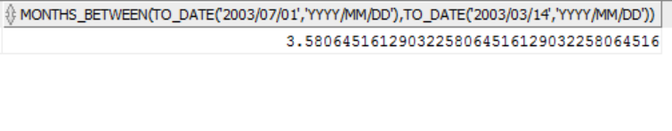
Date Functions
MONTHS_BETWEEN
ADD_MONTHS
NEXT_DAY
LAST_DAY
ROUND
Course Content
Restricting & Sorting
Single Row Functions
MONTHS_BETWEEN
Joining Multiple Tables
Aggregation
The Oracle/PLSQL MONTHS_BETWEEN function returns the number of months between date1 and date2.
Analytical Functions
SELECT MONTHS_BETWEEN (TO_DATE ('2003/07/01', 'yyyy/mm/dd'), TO_DATE ('2003/03/14', 'yyyy/mm/dd') ) FROM DUAL;
Subqueries
Set Operators
Hierarchical Retrieval
Additional Practice
Appendix

Slide 23
ADD_MONTHS, LAST_DAY, NEXT_DATE
ADD_MONTHS: Adds the specified number of months to a date
LAST_DAY: Returns the date of the last day of the month for a given date
NEXT_DATE: Returns the date of the first day after the specified date which falls on the specified day of the week.
Course Content
Restricting & Sorting
Single Row Functions
Joining Multiple Tables
ADD_MONTHS ('12-JAN-1995', 3) ==> 12-APR-1995
LAST_DAY ('12-JAN-99') ==> 31-JAN-1999
NEXT_DAY ('01-JAN-1997', 'MONDAY') ==> 06-JAN-1997
Aggregation
Analytical Functions
Subqueries
Set Operators
Hierarchical Retrieval
Additional Practice
Appendix

Slide 24
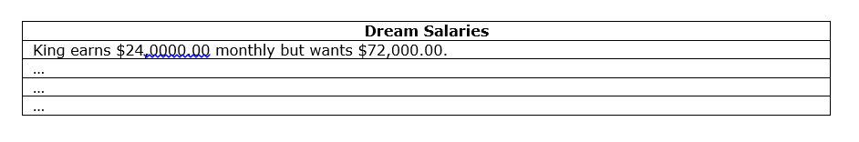
Practice Exercise
For each employee, display employee Id, last name, Salary, and the salary increased by 15% and expressed as a whole number. Label the column as New Salary. Add one more column that subtracts the old salary from New Salary and label the column as increase
Write a query that displays the employees’ last names with first letter capitalized and all other letters lowercase and the length of the names, for all employees whose name start with J, A or M. Sort the results by employees’ last names
Name Length
Abel 4
Matos 5
Mourgos 7
For each employee, display the last name and calculate the number of months worked between today and the date the employee was hired. Label the column MONTHS_WORKED. Order your results by the number of months worked. Round the number of months up to the closest whole number
Write a query that produces the following for each employee
employee <last name> earns <salary> monthly but wants <3 times salary>. Label the column, “Dream Salaries”
Course Content
Restricting & Sorting
Single Row Functions
Joining Multiple Tables
Aggregation
Analytical Functions
Subqueries
Set Operators
Hierarchical Retrieval
Additional Practice
Appendix
Notes:
-- select * from employees-- 1. For each employee, display employee Id, last name, Salary, and the salary increased-- by 15% and expressed as a whole number. Label the column as New Salary.-- Add one more column that subtracts the old salary from New Salary and label the -- column as increase-- select employee_id, last_name, salary, salary*1.15 new_salary, salary*0.15 increase from employees;--2. Write a query that displays the employees’ last names with first letter capitalized and all other letters lowercase and the length of the names, for all employees whose name start with J, A or M. Sort the results by employees’ last names-- Name Length-- Abel 4-- Matos 5-- Mourgos 7-- select initcap(last_name) name, length(last_name) length from employees -- where last_name like 'M%'or last_name like 'J%'or last_name like 'A%'; -- 3.For each employee, display the last name and calculate the number of months worked between today and the date selec-- select employee_id, last_name, round(months_between(sysdate,hire_date)) MONTHS_WORKED -- from employees order by 3 desc;-- 4.Write a query that produces the following for each employee-- employee <last name> earns <salary> monthly but wants <3 times salary>. Label the column, “Dream Salaries”-- select last_name ||' earns'||to_char(salary,'$99,999.00')||' monthly but wants'||to_char(3*salary,'$99,999.00')||'.' "Dream Salaries" from employees;

Slide 25
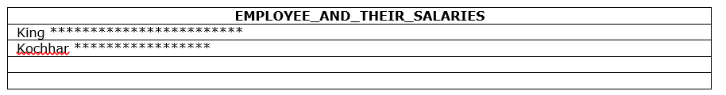
Practice Exercise contd …
Display each employee’s last name, hire date, and salary review date, which is the first Monday after six months of service. Label the column, REVIEW. Format the dates to appear similar to “Monday, the Thirty-First of July, 2000”
l
Display last name, hire date, and day of week on which employee started. Label the column “DAY”. Order the results by the day of the week starting with Monday
Create a query that displays the employees’ last names and commission percentages. If an employee does not earn commission, put “No Commission.” Label the column COMM
Create a query that displays the employees’ last names and indicates the amounts of their annual salaries with asterisks. Each asterisk signifies a thousand dollars. Sort the data in descending order of salary. Label the column EMPLOYEES_AND_THEIR_SALARIES
Course Content
Restricting & Sorting
Single Row Functions
Joining Multiple Tables
Aggregation
Analytical Functions
Subqueries
Set Operators
Hierarchical Retrieval
Additional Practice
Appendix
Notes:
-- 5.Display each employee’s last name, hire date, and salary review date, which is the first Monday after six months of service. Label the column, REVIEW. Format the dates to appear similar to “Monday, the Thirty-First of July, 2000”-- select last_name, hire_date, to_char(next_day(add_months(hire_date,6),'monday'),'Day'||'') as "REVIEW" from employees;-- select last_name, hire_date,next_day(trunc(add_months(hire_date,6),'mm'),'monday') review,-- to_char(next_day(trunc(add_months(hire_date,6),'mm'),'monday'),'Day,"the" Ddspth "of" Month YYYY') Review_date-- FROM employees-- 6.Display last name, hire date, and day of week on which employee started. Label the column “DAY”. Order the results by the day of the week starting with Monday-- select last_name, hire_date, to_char(hire_date,'Day') day from employees order by 3;-- 7.Create a query that displays the employees’ last names and commission percentages. If an employee does not earn commission, put “No Commission.” Label the column COMM-- select last_name, NVL(to_char(commission_pct),'No Commission') comm from employees;-- select * from employees;-- 8.Create a query that displays the employees’ last names and indicates the amounts of their annual salaries with asterisks. Each asterisk signifies a thousand dollars. Sort the data in descending order of salary. Label the column EMPLOYEES_AND_THEIR_SALARIES--

Slide 26
Practice Exercise contd …
Using the decode function, write a query that displays the grade of all employees based on the value of the column, JOB_ID, as per below
JOB GRADE
AD_PRES A
ST_MAN B
IT_PROG C
SA_REP D
ST_CLERK E
None of the above 0
Rewrite the preceding SQL with case statement
Course Content
Restricting & Sorting
Single Row Functions
Joining Multiple Tables
Aggregation
Analytical Functions
Subqueries
Set Operators
Hierarchical Retrieval
Additional Practice
Appendix
Notes:
select DISTINCT job_id , decode(job_id,'AD_PRES','A','ST_MAN','B','IT_PROG','C','SA_REP','D','ST_CLERK','E',NULL) gradefrom employees order by 2;
select distinct JOB_ID,CASE JOB_IDwhen 'AD_PRES' THEN 'A'WHEN 'IT_PROG' THEN 'C'WHEN 'ST_MAN' THEN 'B'WHEN 'SA_REP' THEN 'D'WHEN 'ST_CLERK' THEN 'E'ELSE NULLEND AS GRADEfrom employeesorder by 2;

Slide 27

Course Content
Restricting & Sorting
Single Row Functions
Joining Multiple Tables
Joining Multiple Tables
Aggregation
Analytical Functions
Subqueries
Set Operators
Hierarchical Retrieval
Appendix

Slide 28
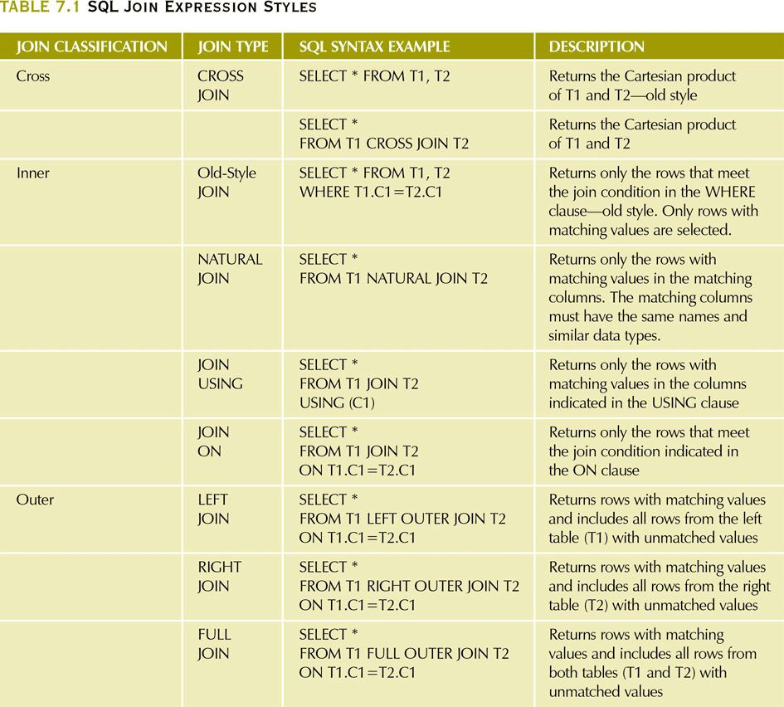
SQL Join Expression Styles
Course Content
Restricting & Sorting
Single Row Functions
Joining Multiple Tables
Aggregation
Analytical Functions
Subqueries
Set Operators
Hierarchical Retrieval
Additional Practice
Appendix

Slide 29
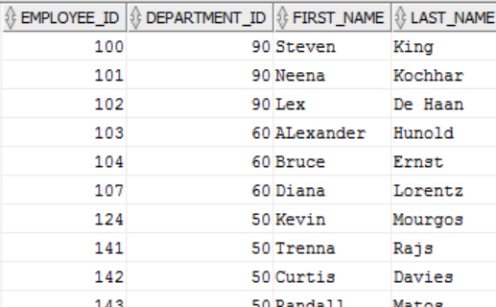
Inner Join
SELECT A.EMPLOYEE_ID,A.DEPARTMENT_ID,FIRST_NAME,LAST_NAME from
EMPLOYEES A
INNER JOIN
DEPARTMENTS B
ON A.DEPARTMENT_ID = B.DEPARTMENT_ID;
Course Content
Restricting & Sorting
Single Row Functions
Joining Multiple Tables
Aggregation
Analytical Functions
Subqueries
Set Operators
Hierarchical Retrieval
Additional Practice
Appendix

Slide 30
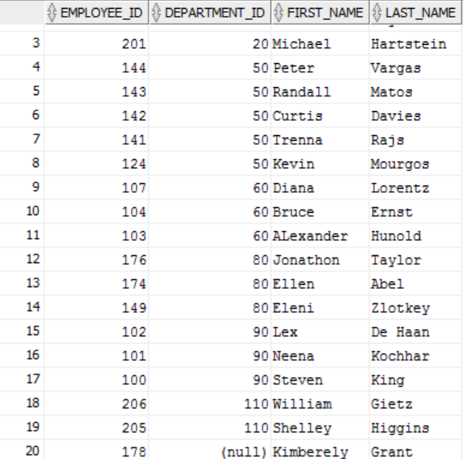
Outer Join
SELECT A.EMPLOYEE_ID,B.DEPARTMENT_ID,FIRST_NAME,LAST_NAME from EMPLOYEES A
LEFT OUTER JOIN
DEPARTMENTS B
ON A.DEPARTMENT_ID = B.DEPARTMENT_ID;
Course Content
Restricting & Sorting
Single Row Functions
Joining Multiple Tables
Aggregation
Analytical Functions
Subqueries
Set Operators
Hierarchical Retrieval
Additional Practice
Appendix

Slide 31
Additional JOIN clauses
JOIN USING – return only the rows with matching vales in the column indicated in the USING clause
This column must exist in both tables
SELECT column-list FROM table1 JOIN table2 USING (common-column)
JOIN ON – when the tables have no common attribute name but the columns have the same attribute type
SELECT column-list FROM table1 JOIN table2 ON join-condition
Course Content
Restricting & Sorting
Single Row Functions
Joining Multiple Tables
Aggregation
Analytical Functions
Subqueries
Set Operators
Hierarchical Retrieval
Additional Practice
Appendix

Slide 32
Practice Exercise
Write a query to display last name, department number, and department name for all employees
Create a unique listing of all jobs that are in department 80. Include Location of department 80 in the output
Write a query to display the employee last name, department name, Location Id, and City of all employees who earn a commission
Write a query to display the last name, job, department number, and department name for all employees, who work in Toronto
Display employee last name, employee number along with their manager’s last name and manager number
Display employee last names, department numbers and all employees who work in the same department as a given employee (Colleague)
Query to display name, job, department name, salary and salary grade for all employees
Query to display name and hire date of any employee, hired after employee Davies
Display names and hire dates for all employees, who were hired before their managers, along with the manager’s name and hire dates
Course Content
Restricting & Sorting
Single Row Functions
Joining Multiple Tables
Aggregation
Analytical Functions
Subqueries
Set Operators
Hierarchical Retrieval
Additional Practice
Appendix
Notes:
1. Write a query to display the last name, department number, and department name for all
employees.
SELECT e.last_name, e.department_id, d.department_name
FROM employees e, departments d
WHERE e.department_id = d.department_id;
2. Create a unique listing of all jobs that are in department 80. Include the location of the
department in the output.
SELECT DISTINCT job_id, location_id
FROM employees, departments
WHERE employees.department_id = departments.department_id
AND employees.department_id = 80;
3. Write a query to display the employee last name, department name, location ID, and city of all
employees who earn a commission.
SELECT e.last_name, d.department_name, d.location_id, l.city
FROM employees e, departments d, locations l
WHERE e.department_id = d.department_id
AND
d.location_id = l.location_id
AND e.commission_pct IS NOT NULL;
4. Display the employee last name and department name for all employees who have an a
(lowercase) in their last names. Place your SQL statement in a text file named test4.sql.
SELECT last_name, department_name
FROM employees, departments
WHERE employees.department_id = departments.department_id
AND last_name LIKE ’%a%’;
5. Write a query to display the last name, job, department number, and department name for all
employees who work in Toronto.
SELECT e.last_name, e.job_id, e.department_id,d.department_name
FROM employees e JOIN departments d
ON (e.department_id = d.department_id)
JOIN locations l
ON (d.location_id = l.location_id)
WHERE LOWER(l.city) = ’toronto’;
6. Display the employee last name and employee number along with their manager’s last name and
manager number. Label the columns Employee , Emp#, Manager, Mgr#, respectively.
Place your SQL statement in a text file named test6.sql.
SELECT w.last_name "Employee", w.employee_id "EMP#",
m.last_name "Manager", m.employee_id "Mgr#"
FROM employees w join employees m
ON (w.manager_id = m.employee_id);
7. Modify test6.sql to display all employees including King, who has no manager.
Place your SQL statement in a text file named test7.sql. Run the query in lab4_7.sql
SELECT w.last_name "Employee", w.employee_id "EMP#",
m.last_name "Manager", m.employee_id "Mgr#"
FROM employees w
LEFT OUTER JOIN employees m
ON (w.manager_id = m.employee_id);
8. Create a query that displays employee last names, department numbers, and all the
employees who work in the same department as a given employee. Give each column an
appropriate label.
SELECT e.department_id department, e.last_name employee,
c.last_name colleague
FROM employees e JOIN employees c
ON (e.department_id = c.department_id)
WHERE e.employee_id <> c.employee_id
ORDER BY e.department_id, e.last_name, c.last_name;
9. Show the structure of the JOB_GRADES table. Create a query that displays the name, job,
department name, salary, and grade for all employees.
DESC JOB_GRADES
SELECT e.last_name, e.job_id, d.department_name,
e.salary, j.grade_level
FROM employees e, departments d, job_grades j
WHERE e.department_id = d.department_id
AND e.salary BETWEEN j.lowest_sal AND j.highest_sal;
-- OR
SELECT e.last_name, e.job_id, d.department_name,e.salary, j.grade_level
FROM employees e JOIN departments d
ON (e.department_id = d.department_id)
JOIN job_grades j
ON (e.salary BETWEEN j.lowest_sal AND j.highest_sal);
10. Create a query to display the name and hire date of any employee hired after employee Davies.
SELECT e.last_name, e.hire_date
FROM employees e, employees davies
WHERE davies.last_name = ’Davies’
AND davies.hire_date < e.hire_date
-- OR
SELECT e.last_name, e.hire_date
FROM employees e JOIN employees davies
ON (davies.last_name = ’Davies’)
WHERE davies.hire_date < e.hire_date;
11. Display the names and hire dates for all employees who were hired before their managers, along
with their manager’s names and hire dates. Label the columns Employee, Emp
Hired, Manager, and Mgr Hired, respectively.
SELECT w.last_name, w.hire_date, m.last_name, m.hire_date
FROM employees w, employees m
WHERE w.manager_id = m.employee_id
AND w.hire_date < m.hire_date;
-- OR
SELECT w.last_name, w.hire_date, m.last_name, m.hire_date
FROM employees w JOIN employees m
ON (w.manager_id = m.employee_id)
WHERE w.hire_date < m.hire_date;

Slide 33

Course Content
Restricting & Sorting
Aggregation
Single Row Functions
Joining Multiple Tables
Aggregation
Analytical Functions
Subqueries
Set Operators
Hierarchical Retrieval
Additional Practice
Appendix

Slide 34
Group Functions
Group functions operate on sets of rows to give one result per group. These sets may be the whole table or the table split into groups. All group functions ignore null values. You can optionally include DISTINCT to make the function consider non-duplicate values. You can group by multiple columns as well.
Course Content
Restricting & Sorting
Single Row Functions
AVG – Evaluates average of an expression over a set of rows
COUNT – Returns the Count of an expression
MAX – Evaluates maximum of an expression over a set of rows
MIN – Evaluates minimum of an expression over a set of rows
STDDEV – Returns Standard Deviation of expression. It is the square root of the variance
SUM – Sum of an expression over a set of rows
VARIANCE – Square of STDDEV
Joining Multiple Tables
Aggregation
Analytical Functions
Subqueries
Set Operators
Hierarchical Retrieval
Additional Practice
Appendix

Slide 35
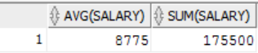
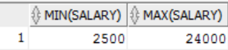
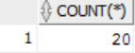
AVG, SUM, MIN, MAX, COUNT
You can use AVG and SUM for numeric data
You can use MIN, MAX, COUNT for any datatype
Course Content
SELECT AVG(salary), SUM(salary)
FROM employees;
SELECT min(salary), max(salary)
FROM employees;
Restricting & Sorting
Single Row Functions
Joining Multiple Tables
Aggregation
Analytical Functions
Subqueries
SELECT COUNT(*)FROM employees;
Set Operators
Hierarchical Retrieval
Additional Practice
Appendix

Slide 36
Group By Clause
SELECT column, group_function (column)
FROM table
[WHERE condition]
[GROUP BY group_by_expression]
[ HAVING group_condition ]
[ORDER BY column] ;
Course Content
Restricting & Sorting
Single Row Functions
Joining Multiple Tables
Order of evaluation of the clauses:
Aggregation
Analytical Functions
WHERE Clause
Group By Clause
Having Clause
Subqueries
Set Operators
Hierarchical Retrieval
Additional Practice
Appendix

Slide 37
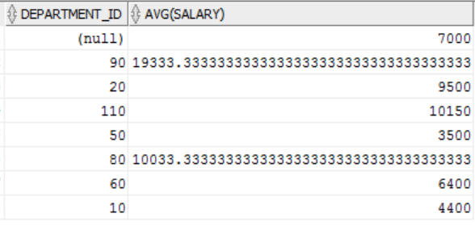
Grouping Data
SELECT DEPARTMENT_ID, AVG(salary)FROM EMPLOYEES GROUP BY DEPARTMENT_ID;
Course Content
Restricting & Sorting
Single Row Functions
Joining Multiple Tables
Aggregation
Analytical Functions
Subqueries
Set Operators
Hierarchical Retrieval
Additional Practice
Appendix

Slide 38
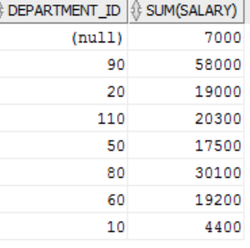
Restricting Groups using HAVING Clause
SELECT DEPARTMENT_ID, sum(salary)FROM EMPLOYEES
GROUP BY DEPARTMENT_ID
having sum(salary)>3500;
Course Content
Restricting & Sorting
Single Row Functions
Joining Multiple Tables
Aggregation
Analytical Functions
Subqueries
Set Operators
Hierarchical Retrieval
Additional Practice
Appendix

Slide 39
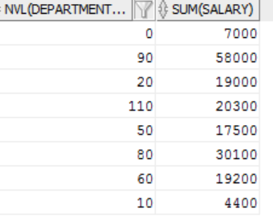
Using the NVL Function with Group Functions
The NVL function forces group functions to include null values
SELECT NVL(DEPARTMENT_ID,0),sum(salary) FROM employees
GROUP BY DEPARTMENT_ID
having sum(salary)>3500;
Course Content
Restricting & Sorting
Single Row Functions
Joining Multiple Tables
Aggregation
Analytical Functions
Subqueries
Set Operators
Hierarchical Retrieval
Additional Practice
Appendix

Slide 40
Practice Exercise
Display highest, lowest, sum and average salary for all employees
Display minimum, maximum, sum and average salary for each job type
Write a query to display the number of people with the same job
Determine the number of managers without listing them. Label the column “Number of Managers”
Write a query to display difference between highest and lowest salaries
Display Manager Number and the salary of the lowest paid employee for that manager. Exclude anyone whose manager is not known. Exclude any groups, where the minimum salary is less than $6,000. Sort the output in descending order of salary
Query to display each department’s name, location, number of employees and average salary for all employees in that department. Round the salary to two decimal places
Create a query that will display the total number of employees and of that total, the number of employees hired in 1995, 1996, 1997, 1998
Display Job, Total salary for that job and total salary for that job against department 20, 50, 90
Course Content
Restricting & Sorting
Single Row Functions
Joining Multiple Tables
Aggregation
Analytical Functions
Subqueries
Set Operators
Hierarchical Retrieval
Additional Practice
Appendix

Slide 41

Course Content
Restricting & Sorting
Analytical Functions
Single Row Functions
Joining Multiple Tables
Aggregation
Analytical Functions
Subqueries
Set Operators
Hierarchical Retrieval
Additional Practice
Appendix

Slide 42
Analytical Functions
Difference between Aggregate and Analytical Function is although analytical function give aggregated result, they do not group by the result set. Analytical functions are computed after all JOINS, WHERE clause, GROUP BY and HAVING clause. They can appear only in the select list and in the main ORDER BY clause of the query.
Course Content
Restricting & Sorting
Single Row Functions
ROW_NUMBER – Assigns a unique number to each row to which it is applied
RANK – Calculates the rank of a hypothetical row identified by the arguments of the function w.r.t to a given sort specification
DENSE_RANK – Similar to rank, but does not skip ranks in case of tie
FIRST and LAST – Used to return first or last value from an ordered sequence
LAG and LEAD – Read from Previous or next row
LISTAGG – Used for string aggregation
Joining Multiple Tables
Aggregation
Analytical Functions
Subqueries
Set Operators
Hierarchical Retrieval
Additional Practice
Appendix

Slide 43
ROW_NUMBER
ROW_NUMBER assigns a unique number to each row to which it is applied (either each row in the partition or each row returned by the query), in the ordered sequence of rows specified in the order by clause, beginning with 1
Course Content
SELECT department_id, first_name, last_name, salary
FROM
(
SELECT
department_id, first_name, last_name, salary,
ROW_NUMBER() OVER (PARTITION BY department_id ORDER BY salary desc) rn
FROM employees
)
WHERE rn <= 3;
Restricting & Sorting
Single Row Functions
Joining Multiple Tables
Aggregation
Analytical Functions
Subqueries
Set Operators
Hierarchical Retrieval
Additional Practice
Appendix

Slide 44
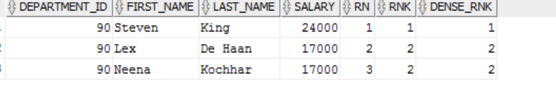
ROW_NUMBER vs RANK vs DENSE_RANK
SELECT department_id, first_name, last_name, salary,ROW_NUMBER() OVER (PARTITION BY DEPARTMENT_ID ORDER BY salary desc) rn,rank() over (PARTITION BY DEPARTMENT_ID order by salary desc) rnk,dense_rank() over ( PARTITION BY DEPARTMENT_ID order by salary desc) dense_rnk FROM employees;
Course Content
Restricting & Sorting
Single Row Functions
Joining Multiple Tables
Aggregation
Analytical Functions
Subqueries
Set Operators
Hierarchical Retrieval
Additional Practice
Appendix

Slide 45
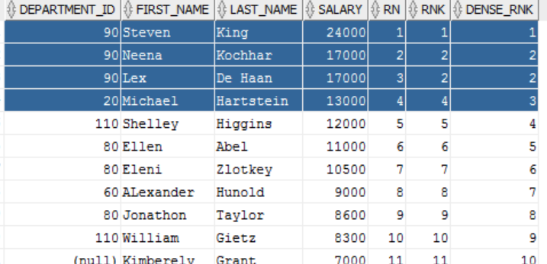
Example Contd..
SELECT department_id, first_name, last_name, salary, ROW_NUMBER() OVER (ORDER BY salary desc) rn,rank() over ( order by salary desc) rnk, dense_rank() over ( order by salary desc) dense_rnk FROM employees;
Course Content
Restricting & Sorting
Single Row Functions
Joining Multiple Tables
Aggregation
Analytical Functions
Subqueries
Set Operators
Hierarchical Retrieval
Additional Practice
Appendix

Slide 46
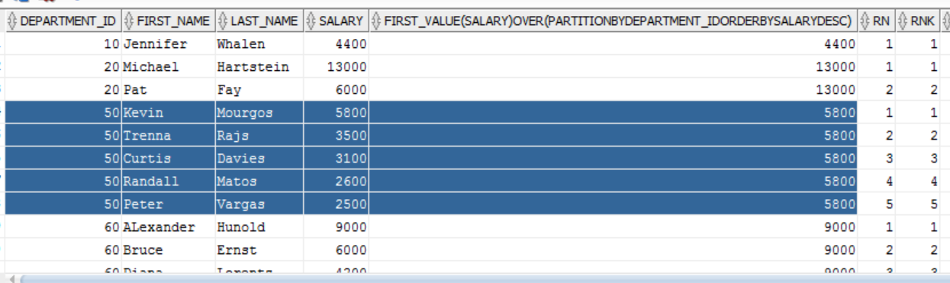
FIRST_VALUE
The FIRST_VALUE analytic function is similar to the FIRST analytic function, allowing you to return the first result from an ordered set
Course Content
SELECT department_id, first_name, last_name, salary,FIRST_VALUE(SALARY) OVER ( PARTITION BY DEPARTMENT_ID ORDER BY salary desc),ROW_NUMBER() OVER ( PARTITION BY DEPARTMENT_ID ORDER BY salary desc) rn,rank() over ( PARTITION BY DEPARTMENT_ID order by salary desc) rnk,dense_rank() over ( PARTITION BY DEPARTMENT_ID order by salary desc) dense_rnk FROM employees ;
Restricting & Sorting
Single Row Functions
Joining Multiple Tables
Aggregation
Analytical Functions
Subqueries
Set Operators
Hierarchical Retrieval
Additional Practice
Appendix

Slide 47
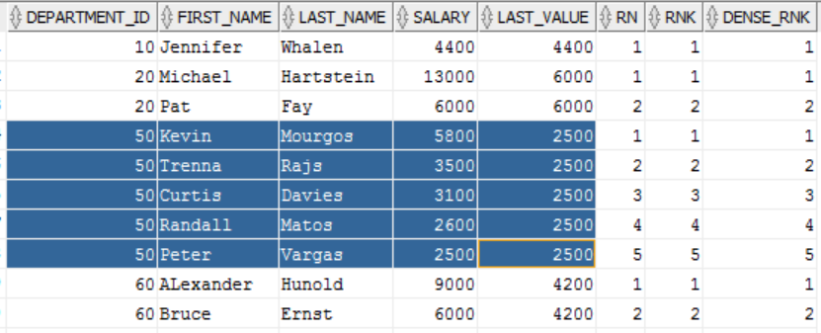
LAST_VALUE
SELECT DEPARTMENT_ID,FIRST_NAME,LAST_NAME, SALARY,LAST_VALUE(SALARY)OVER (PARTITION BY DEPARTMENT_ID ORDER BY SALARY DESC RANGE BETWEEN UNBOUNDED PRECEDING AND UNBOUNDED FOLLOWING) LAST_VALUE,ROW_NUMBER() OVER (PARTITION BY DEPARTMENT_ID ORDER BY salary desc) rn, RANK()over(PARTITION BY DEPARTMENT_ID order by salary desc) rnk, DENSE_rank() over ( PARTITION BY DEPARTMENT_ID order by salary desc) dense_rnk FROM employees;
Course Content
Restricting & Sorting
Single Row Functions
Joining Multiple Tables
Aggregation
Analytical Functions
Subqueries
Set Operators
Hierarchical Retrieval
Additional Practice
Appendix

Slide 48
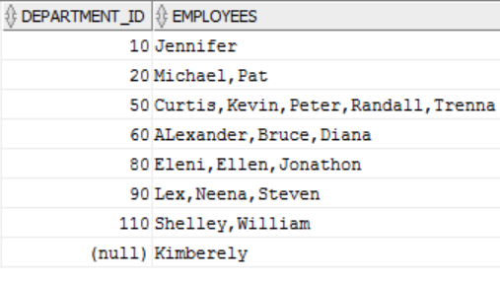
LISTAGG
LISTAGG analytic function was introduced in Oracle 11g Release 2, making it very easy to aggregate strings. The nice thing about this function is it also allows us to order the elements in the concatenated list
Course Content
SELECT DEPARTMENT_ID, LISTAGG(FIRST_NAME, ',') WITHIN GROUP (ORDER BY FIRST_NAME) AS employees
FROM EMPLOYEES
GROUP BY DEPARTMENT_ID;
Restricting & Sorting
Single Row Functions
Joining Multiple Tables
Aggregation
Analytical Functions
Subqueries
Set Operators
Hierarchical Retrieval
Additional Practice
Appendix

Slide 49
Practice Exercise
For each employee, display Employee Id, Last Name and also the count of employees in the same department
Display LAST_NAME, DEPARTMENT_ID, SALARY and Previous Highest salary within that department. Order the results by Department Id and in descending order of salary
Display Employee’s Last Name, Salary and their rank in accordance to descending order of their salary. Ensure that no ranks are skipped
For all employees, display the DEPARTMENT_ID, LAST_NAME, SALARY along with LAST_NAME of the employee who earns lowest salary in that department
Course Content
Restricting & Sorting
Single Row Functions
Joining Multiple Tables
Aggregation
Analytical Functions
Subqueries
Set Operators
Hierarchical Retrieval
Additional Practice
Appendix
Notes:
-- SELECT department_id, first_name, last_name, salary,-- FIRST_VALUE(SALARY) OVER ( PARTITION BY DEPARTMENT_ID ORDER BY salary desc) first_value,-- ROW_NUMBER() OVER (PARTITION BY DEPARTMENT_ID ORDER BY salary desc) rn,-- rank() over (PARTITION BY DEPARTMENT_ID order by salary desc) rnk,-- dense_rank() over (PARTITION BY DEPARTMENT_ID order by salary desc) dense_rnk-- FROM employees ;
-- SELECT department_id, first_name, last_name, salary, -- ROW_NUMBER() OVER (ORDER BY salary desc) rn,-- rank() over ( order by salary desc) rnk, -- dense_rank() over ( order by salary desc) dense_rnk -- FROM employees;-- For each employee, display Employee Id, Last Name and also the count of employees in the same department-- select employee_id, last_name, -- ROW_NUMBER() OVER (PARTITION BY DEPARTMENT_ID ORDER BY 1 desc) rn -- from employees ;-- Display LAST_NAME, DEPARTMENT_ID, SALARY and Previous Highest salary within that department. Order the results by Department Id and in descending order of salary-- select last_name,department_id,salary,-- FIRST_VALUE(salary) OVER (partition by department_id order by salary desc) High_pay_in_department-- from employees-- Display Employee’s Last Name, Salary and their rank in accordance to descending order of their salary. Ensure that no ranks are skipped-- select last_name, salary,-- rank() over (order by salary desc) rk -- from employees-- For all employees, display the DEPARTMENT_ID, LAST_NAME, SALARY along with LAST_NAME of the employee who earns lowest salary in that department-- select department_id,last_name,salary -- from employees-- where salary in (select min(salary) from employees group by department_id)-- order by department_id;

Slide 50

Course Content
Restricting & Sorting
Subqueries
Single Row Functions
Joining Multiple Tables
Aggregation
Analytical Functions
Subqueries
Set Operators
Hierarchical Retrieval
Additional Practice
Appendix

Slide 51
Subquery Overview
Subquery can return
One single value (one column, one row)
A list of values (one column, multiple rows)
A virtual table (multicolumn, multirow set of values)
NULL
Course Content
Restricting & Sorting
Single Row Functions
Joining Multiple Tables
Types of Subqueries
Aggregation
IN subqueries – You want to find all customers who have purchased something from a list of products, not just one product
HAVING subqueries – restrict a GROUP by applying a conditional criteria to the grouped rows
List all products with the total quantity sold greater than the average quantity sold
INLINE subqueries – can appear as a value in a the column list of a SELECT
Must return one value
CORRELATED subqueries – subquery executes once for each row in the outer row (like nested loops)
Analytical Functions
Subqueries
Set Operators
Hierarchical Retrieval
Additional Practice
Appendix

Slide 52
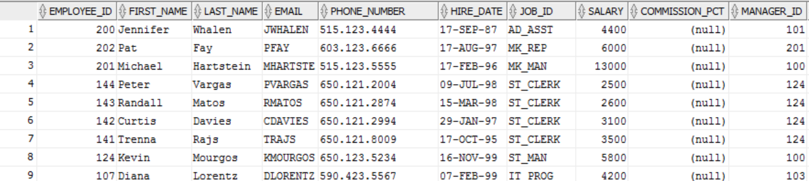
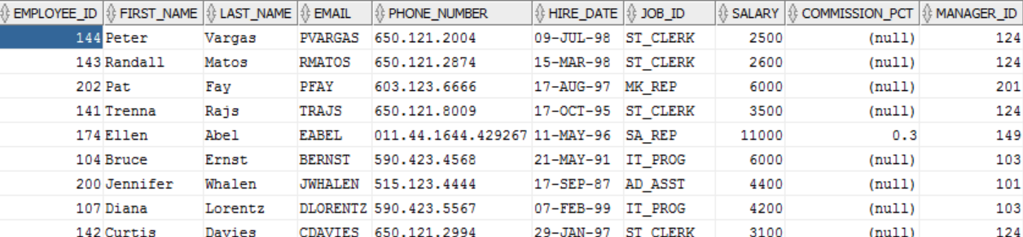
IN Subquery Example
SELECT * FROM EMPLOYEES where DEPARTMENT_ID in (select DEPARTMENT_ID from DEPARTMENTS);
Course Content
Restricting & Sorting
Single Row Functions
Joining Multiple Tables
Aggregation
Analytical Functions
Subqueries
select * from employees where EMPLOYEE_ID not in (select NVL(manager_id,0) from employees);
Set Operators
Hierarchical Retrieval
Additional Practice
Appendix

Slide 53
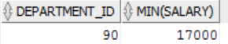
HAVING Subquery Example
Display the department number and its lowest salary for the department with the highest average salary
SELECT DEPARTMENT_ID,MIN(SALARY) FROM EMPLOYEES GROUP BY DEPARTMENT_ID HAVING AVG(SALARY) = (SELECT MAX(AVG(SALARY)) FROM EMPLOYEES GROUP BY DEPARTMENT_ID);
Course Content
Restricting & Sorting
Single Row Functions
Joining Multiple Tables
Aggregation
Analytical Functions
Subqueries
Set Operators
Hierarchical Retrieval
Additional Practice
Appendix

Slide 54
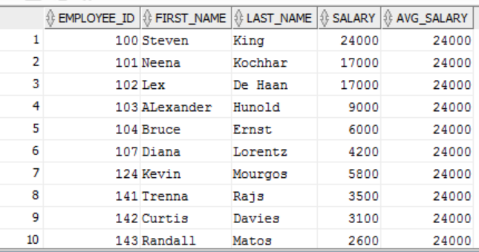
Inline Subquery Example
select EMPLOYEE_ID,FIRST_NAME,LAST_NAME,SALARY, (SELECT MAX(SALARY) FROM EMPLOYEES) AS AVG_SALARY from employees;
Course Content
Restricting & Sorting
Single Row Functions
Joining Multiple Tables
Aggregation
Analytical Functions
Subqueries
Set Operators
Hierarchical Retrieval
Additional Practice
Appendix

Slide 55
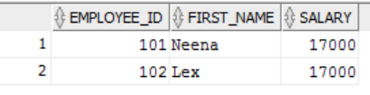
Correlated Subquery Example
SELECT EMPLOYEE_ID,FIRST_NAME ,A.SALARY FROM EMPLOYEES A
WHERE 1=(SELECT COUNT(DISTINCT B.SALARY) FROM EMPLOYEES B WHERE A.SALARY<B.SALARY);
Course Content
Restricting & Sorting
Single Row Functions
Joining Multiple Tables
Aggregation
Analytical Functions
Subqueries
Set Operators
Hierarchical Retrieval
Additional Practice
Appendix

Slide 56
EXISTS and WITH clause
The EXISTS clause
EXISTS operator tests for existence of rows in the result set of the subquery
If a subquery row value is found:
The search does not continue in the inner query
The condition is flagged TRUE
If a subquery row value is not found:
The condition is flagged FALSE
The search continues in the inner query
select * from employees e where exists (select * from departments d where d.department_id = e.department_id and d.location_id=1400);
Course Content
Restricting & Sorting
Single Row Functions
Joining Multiple Tables
Aggregation
Analytical Functions
The WITH Clause
Subqueries
Using WITH clause, you can use the same query block in a SELECT statement, when it occurs more than once within a complex query
The WITH Clause retrieves the results of a query block and stores it in user’s temporary tablespace
The WITH Clause improves performance
Set Operators
Hierarchical Retrieval
Additional Practice
Appendix

Slide 57
Practice Exercise
Write a query to display last name, hire date of any employee in the same department as Zlotkey. Exclude Zlotkey
Display Employee Numbers and last names of all employees who earn more than the average salary
Query to display employee numbers and last names of all employees who work in a department with any employee whose last name contains a u
Display last name, department number, and job id of all employees whose department location Id is 1700
Display last name and salary of every employee who reports to King
Display employee numbers, last names and salaries of all employees who earn more than the average salary and who work with any employee with a u in their name
Write a query to display last name, department number and salary of any employee whose department number and salary both match the department number and salary of any employee who earns a commission
Display last name, department name and salary of any employee whose salary and commission match the salary and commission of any employee located in Location Id 1700
Query to display last name, hire date and salary for all employees who have same salary and commission as Kochhar
Course Content
Restricting & Sorting
Single Row Functions
Joining Multiple Tables
Aggregation
Analytical Functions
Subqueries
Set Operators
Hierarchical Retrieval
Additional Practice
Appendix

Slide 58
Practice Exercise contd …
Query to display employees who earn a salary that is higher than the salary of all of the Sales Manager (JOB_ID = ‘SA_MAN’). Sort the results on salary from highest to lowest
Display Employee Id, last name and department Id of those employees who live in cities whose name begins with T
Query to find all employees who earn more than the average salary in their departments. Display last name, salary, department Id and the average salary for the department. Sort by average salary
Find all employees who are not supervisors. Use NOT EXISTS operator. Can this be done by NOT IN operator? How or why not?
Write a query to display last names of the employees who earn less than the average salary in their departments
Display last names of employees who have one or more co-workers in their department with later hire dates but higher salaries
Write a query to display the department names of those departments whose total salary cost is above one eight (1/8) of the total salary cost of the whole company. Use WITH clause
Course Content
Restricting & Sorting
Single Row Functions
Joining Multiple Tables
Aggregation
Analytical Functions
Subqueries
Set Operators
Hierarchical Retrieval
Additional Practice
Appendix

Slide 59

Course Content
Restricting & Sorting
Set Operators
Single Row Functions
Joining Multiple Tables
Aggregation
Analytical Functions
Subqueries
Set Operators
Hierarchical Retrieval
Additional Practice
Appendix

Slide 60
UNION
Combine two companies customer lists where they have names in common so that the final list has no duplicate names
Column names and their attributes must be the same
Can include more than two tables where applicable
Course Content
SELECT <COLUMN NAMES> FROM CUSTOMER
UNION
SELECT <COLUMN NAMES> FROM CUSTOMER_2;
Restricting & Sorting
Single Row Functions
Joining Multiple Tables
Aggregation
SELECT <COLUMN NAMES> FROM T1 UNION
SELECT <COLUMN NAMES> FROM T2 UNION
SELECT <COLUMN NAMES> FROM T3;
Analytical Functions
Subqueries
Set Operators
Hierarchical Retrieval
Additional Practice
Appendix

Slide 61
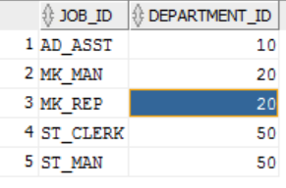
UNION Example
SELECT JOB_ID, DEPARTMENT_ID FROM EMPLOYEES WHERE DEPARTMENT_ID = 10
UNION
SELECT JOB_ID, DEPARTMENT_ID FROM EMPLOYEES WHERE DEPARTMENT_ID = 50
UNION
SELECT JOB_ID, DEPARTMENT_ID FROM EMPLOYEES WHERE DEPARTMENT_ID = 20 ;
Course Content
Restricting & Sorting
Single Row Functions
Joining Multiple Tables
Aggregation
Analytical Functions
Subqueries
Set Operators
Hierarchical Retrieval
Additional Practice
Appendix

Slide 62
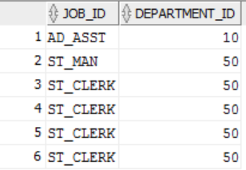
UNION ALL
UNION ALL merges the tables but keeps duplicates in the result table
Course Content
Restricting & Sorting
SELECT JOB_ID, DEPARTMENT_ID FROM EMPLOYEES WHERE DEPARTMENT_ID = 10
UNION ALL
SELECT JOB_ID, DEPARTMENT_ID FROM EMPLOYEES WHERE DEPARTMENT_ID = 50
Single Row Functions
Joining Multiple Tables
Aggregation
Analytical Functions
Subqueries
Set Operators
Hierarchical Retrieval
Additional Practice
Appendix

Slide 63
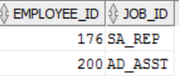
Intersect
Find records that are common in both tables
SELECT EMPLOYEE_ID, JOB_ID FROM EMPLOYEES INTERSECT SELECT EMPLOYEE_ID, JOB_ID FROM JOB_HISTORY;
Course Content
Restricting & Sorting
Single Row Functions
Joining Multiple Tables
Aggregation
Analytical Functions
Subqueries
Set Operators
Hierarchical Retrieval
Additional Practice
Appendix

Slide 64
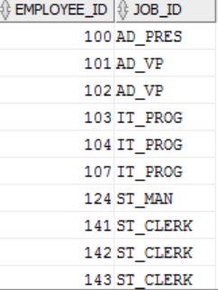
Minus
Combines rows from two queries and returns only those rows that appear in the first set but not the second
Course Content
SELECT EMPLOYEE_ID, JOB_ID FROM EMPLOYEES MINUS SELECT EMPLOYEE_ID, JOB_ID FROM JOB_HISTORY;
Restricting & Sorting
Single Row Functions
Joining Multiple Tables
Aggregation
Analytical Functions
Subqueries
Set Operators
Hierarchical Retrieval
Additional Practice
Appendix

Slide 65
Practice Exercise
List the department Ids for department that do not contain the Job Id ST_CLERK using SET operators
Display the Country Id and names of the countries that have no departments located in them, using SET operators
Produce a list of jobs for departments 10, 50 and 20, in that order. Display JOB Id and Department Id, using SET operators
List the employee Ids and Job Ids of those employees who are currently in the job title that they have held once before during their tenure with the company
Course Content
Restricting & Sorting
Single Row Functions
Joining Multiple Tables
Aggregation
Analytical Functions
Subqueries
Set Operators
Hierarchical Retrieval
Additional Practice
Appendix

Slide 66

Course Content
Restricting & Sorting
Hierarchical Retrieval
Single Row Functions
Joining Multiple Tables
Aggregation
Analytical Functions
Subqueries
Set Operators
Hierarchical Retrieval
Additional Practice
Appendix

Slide 67
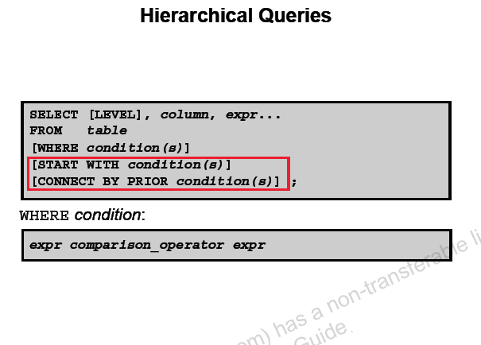
HIERARCHICAL Retrieval
Hierarchical Retrieval retrieves data based on natural hierarchical relationship between rows in table
Course Content
Restricting & Sorting
Single Row Functions
Joining Multiple Tables
Aggregation
Analytical Functions
Subqueries
Set Operators
Hierarchical Retrieval
Additional Practice
Appendix

Slide 68
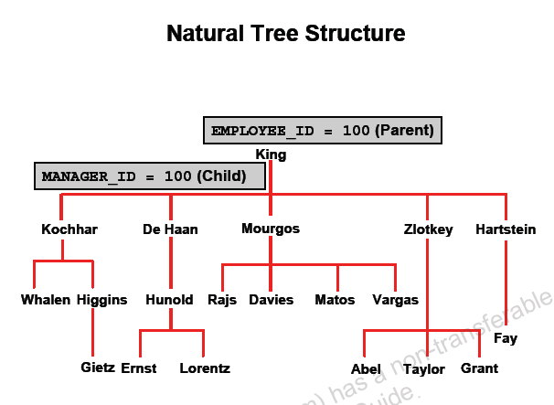
Nodes and Branches
Course Content
Restricting & Sorting
Single Row Functions
Joining Multiple Tables
Aggregation
Analytical Functions
Subqueries
Set Operators
Hierarchical Retrieval
Additional Practice
Appendix

Slide 69
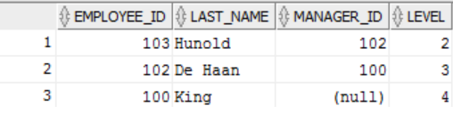
Examples:
Create a report that shows the hierarchy of the managers for the employee Lorentz. Display his immediate manager first
Course Content
SELECT EMPLOYEE_ID, LAST_NAME, MANAGER_ID,LEVEL FROM EMPLOYEES WHERE LAST_NAME <> 'Lorentz' START WITH LAST_NAME = 'Lorentz' CONNECT BY PRIOR MANAGER_ID = EMPLOYEE_ID;
Restricting & Sorting
Single Row Functions
Joining Multiple Tables
Aggregation
Analytical Functions
Subqueries
Set Operators
Hierarchical Retrieval
Additional Practice
Appendix

Slide 70
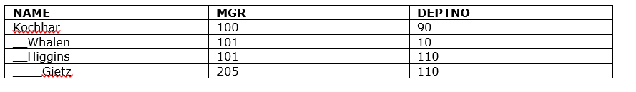
Practice Exercise
Produce a report showing an organization chart for Mourgo’s department. Print last name, salaries and department Ids
Create a report that shows the hierarchy of the managers for the employee Lorentz. Display his immediate manager first
Create an indented report showing the management hierarchy starting from the employee whose last name is Kochhar. Print the employee’s last name, manager Id and department Id. Give alias names to the column names as shown in the output
Course Content
Restricting & Sorting
Single Row Functions
Joining Multiple Tables
Aggregation
Analytical Functions
Subqueries
Set Operators
Hierarchical Retrieval
Additional Practice
Appendix

Slide 71
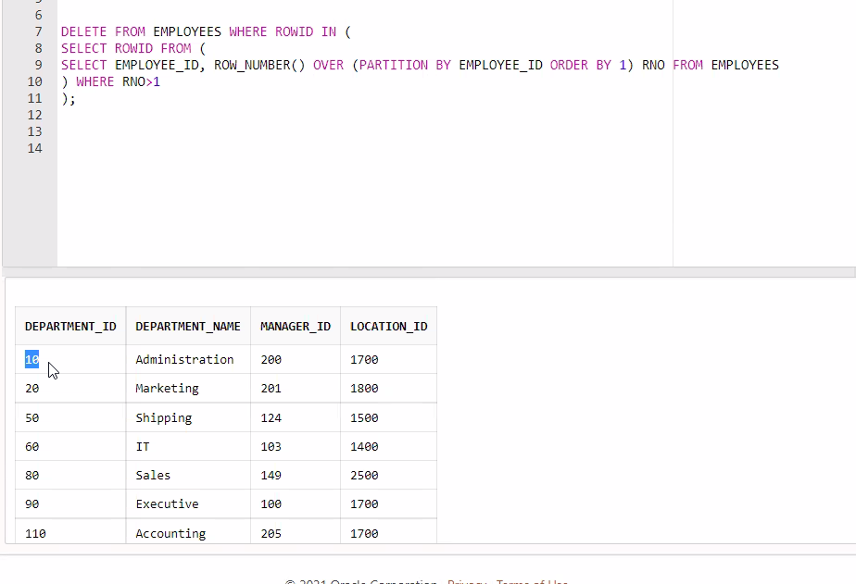

Slide 72

Course Content
Restricting & Sorting
Additional Practice
Single Row Functions
Joining Multiple Tables
Aggregation
Analytical Functions
Subqueries
Set Operators
Hierarchical Retrieval
Additional Practice
Appendix

Slide 73
Practice Exercise
Show all data of clerks who have been hired after the year 1997
Show the employees that have no commission with a 10% raise in their salary (Round off the salaries)
Show the last names of all employees together with the number of years and months they have completed
Show those employees that have a name starting with J,K,L, or M
Show all employees, and indicate with ”Yes” or “No” whether they receive commission
Show department names, locations, names, job, titles, and salaries of employees who work in location 1800
How many employees have a name that ends with “n”?
Show the names and locations for all the departments and the number of employees, working in each department. Make sure that departments without employees are included as well
Which jobs are found in department 10 & 20?
Which jobs are found in Administration and Executive departments, and how many employees do these jobs? Show the job with highest frequency first
Course Content
Restricting & Sorting
Single Row Functions
Joining Multiple Tables
Aggregation
Analytical Functions
Subqueries
Set Operators
Hierarchical Retrieval
Additional Practice
Appendix

Slide 74
Practice Exercise Contd..
Show all employees, who have managers with a salary higher than $15000. Show the following data: employee name, manager name, manager salary, and salary grade of the manager
Show all employees, who have managers with a salary higher than $15000. Show the following data: employee name, manager name, manager salary, and salary grade of the manager
Display the department number and its lowest salary for the department with the highest average salary
Display Department Number, Department Name, Manager Id and Location Id for departments where no Sales Rep work
Show department number, department name, and number of employees working in each department that
Includes fewer than 3 employees
Has the highest number of employees
Has the lowest number of employees
Show all employees who were hired on the day of week on which the highest number of employees has been hired
Write a query to display top 3 earners in EMPLOYEES table. Display the last names and their salary
Write a query to display Job Ids of those jobs, whose maximum salary is half the maximum salary in the whole company. Use WITH Clause
Display LAST_NAME, HIRE_DATE in descending order of their HIRE_DATE. If two consecutive records have a hire date difference of more than 12 months, then do not display them
Course Content
Restricting & Sorting
Single Row Functions
Joining Multiple Tables
Aggregation
Analytical Functions
Subqueries
Set Operators
Hierarchical Retrieval
Additional Practice
Appendix

Slide 75
Course Content
Restricting & Sorting
Appendix
Single Row Functions
Joining Multiple Tables
Aggregation
Analytical Functions
Subqueries
Set Operators
Hierarchical Retrieval
Additional Practice
Appendix

Slide 76
Reference Material
S No | Name | Artefact
1 | Table DDLs and DMLs for the practice exercises
2 | Training Supplement
Course Content
Restricting & Sorting
Single Row Functions
Joining Multiple Tables
Aggregation
Analytical Functions
Subqueries
Set Operators
Hierarchical Retrieval
Additional Practice
Appendix

